Slide 1

Safety Committee Updates
Cary Ernest

Slide 2
MEMBERS
AM Contractors
Vendors
Clients
Attorneys
Engineers

Slide 3
INNOVATIONS
New PPE for hard hats, vests, halos lights, etc.
Lights (red, blue, amber, white) on trucks where permitted
Use of dolly's for cones placement
Hands-free communication for mobile operations
GPS alerts: speeding, hard braking, quick starts, harsh cornering, GEO fence, idling time, etc.
TMAs used as Road Ranger trucks – pilot program underway in Treasure Coast
iCone on arrow boards
Staging areas in construction zones along with TMA
Forward-facing dashcam usage on all trucks

Slide 4
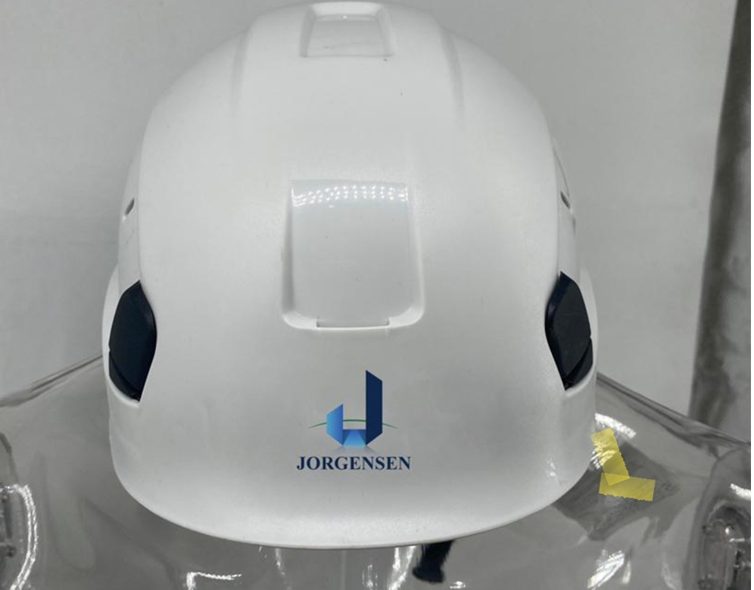

Slide 5
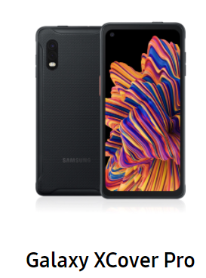
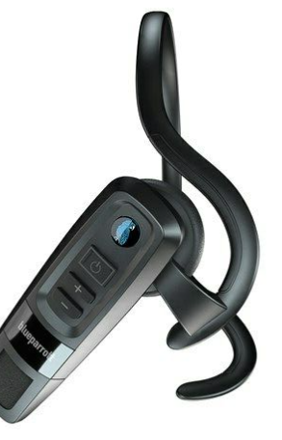
Savings
Ruggedized Phone – Military spec
Teams Walkie Talkie Headset
10 Hours of Talk Time
Designed for front-line workers, hard hat compliant, water resistant, etc.
Noise cancellation
One Button Teams Walkie Talkie
Voice Activated answer/call, etc.
300 ft range, can leave the phone in the truck
Drastic Reduction in Phone Damage and Replacements (90%)
No Need for
  Cases
  Walkie-Talkies
  other Headsets

Slide 6
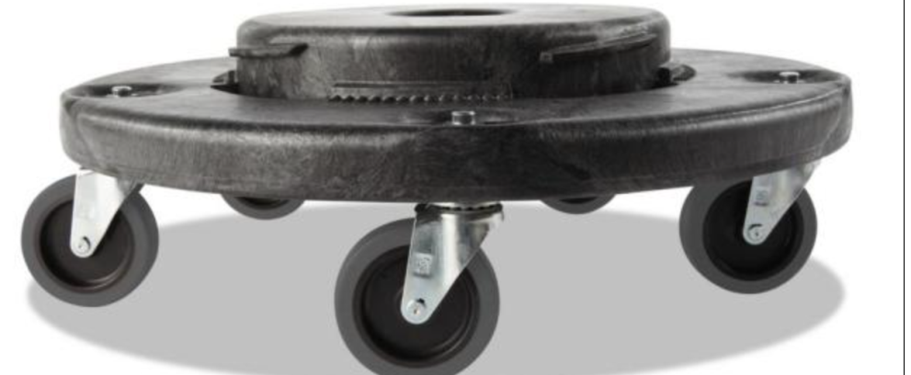
DOLLY
Reduces time in half by setting up MOT

Slide 7
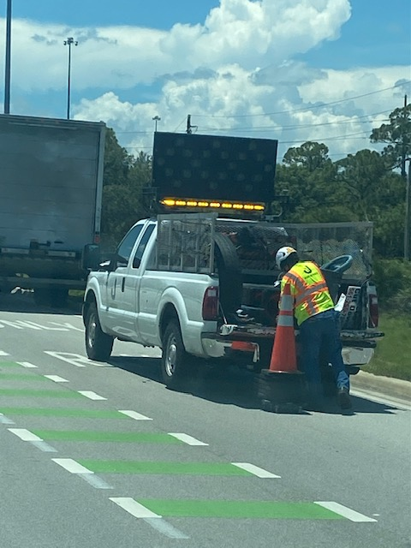

Slide 8
